Slide 1
Victorian Aboriginal Child Care Agency (VACCA) Executive Director Presentation - Design Shop 3 Co-designing services funded under Priority 2 of the Third National Family Violence Action Plan

Slide 2
Victorian Aboriginal Child Care Agency - VACCA
VACCA is an Aboriginal community controlled organisation and was established in 1977. It is the leading Aboriginal child and family welfare organisation in Victoria.
VACCA provides Aboriginal children, families and communities with services premised on human rights, self-determination, cultural respect and safety.
Vision: to ensure our children, young people, families and communities are thriving – culturally strong, empowered and safe.
Purpose: to work towards the healing of the Aboriginal community through strengthening the safety, wellbeing and cultural connectedness of vulnerable community members, particularly children.
For more information see www.vacca.org

Slide 3
Celebrating 40 years
Growth since 1996
1996 | 2003 | 2010 | 2017
6 Programs 34 staff 4 vehicles, two computers CEO managed all staff Crisis mgt approach Serious financial mgt issues Serious operational issues Budget $2m | 13 Programs 95 staff 50 vehicles 94 computers 5 Program Managers Period of significant growth, had trust of funders – preparedness to invest in VACCA. A time of consolidation, reviewing structure and improving systems. Budget $5m | 30 Programs 160+ staff 70 plus vehicles Excess 160 computers Executive Mgt Group Leadership Group Corporate & Finance Unit Research and Policy Unit New Programs, Projects and Initiatives Quality – Registration Family violence Budget $11.6m | 45+ Programs 380+ staff 111 vehicles Stronger Mgt infrastructure Stronger Corporate & Client Services Infrastructure Focus on quality practice Investment in business systems Growth – Eastern, Southern, Western, & Gippsland regions incl new focus on youth, justice, homelessness, health and mens programs Guardianship Therapeutic service delivery Kinship growth Transitioning of Aboriginal children Workforce strategy Information Management Strategy Technology Strategy Communications and Fundraising strategy Investment evidence based informed approaches Increased cultural and community programs all sites Increased investment training and project mgt Benchmarking embedded as ongoing approach Increase focused on evidence informed programs Budget $35m plus
Notes:
Acknowledge Country and Traditional Owners. Thank Auntie Di Kerr. Thank the Training Team particularly Kerri Jackson for putting another in-service together.
In my presentation today I will provide you with a summary of the last six months of our activities this year and look ahead to the next six.
I will briefly discuss the new structure of VACCA, the key areas of Roadmap for Reform service innovation and the impact of the Family Violence Royal Commission.
I will also update you about the community discussions with the State Government on Treaty and self-determination and what self-determination means for our clients and community and for us in service delivery.
Our In-service theme: “Bring them home: Securing the Rights of our Children” mirrors the SNAICC Conference theme, and we replicate it today for a couple of reasons. First, because 2017 is twenty years since the release of the Bringing The Home, the final report of the Human Rights and Equal Opportunity Commission’s National Inquiry into the Separation of Aboriginal and Torres Strait Islander Children from their Families; and second this year, as well as 2016 and the next 2018 will be very important years in advances we can make and indeed are making in further advancing the rights of Aboriginal children.
That's not me as Muriel but you as VACCA. The things we are doing around culture are world leading. Will hear about something from linkup.

Slide 4
Building and sustaining growth: the importance of back of house innovation
We undertook ‘benchmarking’ activities to review the cost and quality of five ‘back of house’ systems: HR, Finance, ICT, Payroll, Fleet
We utilised benchmarking to review salaries
We developed 5 year strategies for ICT, Information Management, Workforce, Infrastructure.
We undertook three separate reviews to address growth and service delivery. It resulted in three organisational restructures over the last 5 years.
Invested in skilled Corporate managers to strengthen business processes and operations.
Our ‘back of house’ focus resulted in VACCA being a final is the 2014 Indigenous Governance Awards
We have invested in CQI resources and project mgt
Notes:
In 1996 VACCA had a back of house that included a Finance Officer and assistant. Their role was finance, HR, Fleet & Property mgt at that time IT and computers were non existent. At a certain point in our development we became aware that we needed specialist human resources functions as well as a responsive finance system. Information Technology, client information systems and Fleet management systems were also urgent but was addressed in ‘Phase two’ of our business systems solution strategy.
Addressing these issues then meant we needed to compare ourselves with others in the sector and we were fortunate that the State Government was supporting the NFP sector through a number of projects including the “Back of House” Benchmarking Study. The Nous NFP Benchmarking Project was established in 2012 ( need to check) as a sector specific benchmarking project undertaken by the NOUS Group to compare the cost and quality of five back of house functions over a three year period. Twelve NFP organisations were involved and VACCA participated in the final year of the project after our new systems had been implemented.
The five back of house functions analysed were: HR Finance, ICT, Payroll, Fleet. The analysis revealed that VACCA invested only marginally less in back of house services per EFT than the group average. However our back of house spend in 12/13 was 14% of organisational expenditure compared with the benchmark average of 10.5% . VACCA’s staff satisfaction with all five functions was equal to or higher than the group average.
In my early days at VACCA it was obvious also that our process of paying our staff according to the funding we received from government for particular programs was becoming problematic across the organisation wo we began to address salaries across our agency and according to our own organisation needs. To do this we engaged specialist to conduct salary benchmarking for us and have continued to do so on three occasions over the last 20 years. At times we went to the broader NFP sector to be able to tell how we compared with the rest of the NFP sector. Indeed we surprised ourselves by discovering often that we were doing much better than we thought!
Our growth also meant we needed to reassess out infrastructure and accommodation needs and where our services would be best located. To do this we commissioned a study based on demographic trends which was largely implemented although we are constantly monitoring this.
Rapid growth has also meant revising our organisational structure and management on several occasions and investing in specialist skills to equip staff to operate in an ever increasing complex and highly regulated environment. These additional skill sets have been quality & compliance, finance, human resources, IR, asset management, client practise, communications, fundraising and more recently, organisational development to implement our workforce strategy. Not only are these skills embedded in our operations, they are being used to develop and train our Aboriginal staff who may not otherwise have had the opportunity or experience to gain such knowledge. We believe being technically skilled and having cultural expertise is a deadly combination and it will certainly ensure our Aboriginal and non Aboriginal staff are highly valued and sought after in our sector. ……not that we want to loose anyone!
We have also developed a five year ICT Plan and a Information Management plan. Our current business systems and corporate services functions implemented 4 years ago will be able to support further anticipated growth over the next few years. ( which is wonderful…and demonstrates the foresight and wisdom of the VACCA Board to invest heavily in VACCA’s back of house business.
The other benefit to our community is that we can offer work to Aboriginal people that isn’t just in the coalface service delivery areas but also in finance, HR, and Fleet and facilities management. 50% of VACCA’s corporate staff are Aboriginal. We also have Aboriginal fleet mgrs, IT

Slide 6
Our Programs and Services
Early years support
Playgroups x 8 metro wide
Child protection support service
Lakidjeka ACSASS
Family finding
Aboriginal Family Led Decision-Making
Adult support services
Homelessness Support Services
Justice Support Services
Drug and Alcohol Support Services
Emergency Relief
Adult Healing services
Link-Up Victoria
Royal Commission into Institutional Responses to Child Sexual Abuse Support Service
Koorie Connect
External Training
Nikara’s journey
CSP state wide roll out
Cultural competency
Sector and DHHS training
Out of home care,
placement & support
Kinship Care
Extended Care (Home Based Care)
Permanent Care
Aboriginal Adolescent Community Placement House
Therapeutic Residential Care x 3 units
Lead Tennant
Leaving Care
CIRC Education Support
Family Finding
Koorie Cultural Placement and Support
Foster Care Assessment and Recruitment
Targeted Care
Aboriginal Children’s Healing Team
Nugel (Aboriginal Guardianship - Section 18)
Internal Business Services
Continuous Quality Improvement
Corporate Services (Finance, Payroll, HR, Asset management, ICT, Organisational Development)
Cultural Care & Strengthening Programs
Koorie FaCES
Koorie Youth Traineeships
Cultural Support Planning
Cultural Support and Development
Possum skin cloak
Cultural camps
Art mentoring
Koorie Kids Stay at School
Dad’s Group
Homework Club
Family and Intensive support services
Aboriginal Child FIRST
Integrated Family Services
Family Mental Health Support
Wilke Kwe (Family Restoration Program)
Aboriginal Stronger Families
Family Restorations
Aboriginal Cradle to Kinder
Barreng Moorop (Youth Justice)
Aboriginal Ice - A&D Care & Recovery Worker
Kurnai Youth Homelessness
Family violence services
Aboriginal Family Violence
Orana Gunyah Crisis Accommodation and Support
Family Violence case Management/Outreach
Family Violence Therapeutic Interventions
Holistic Healing
Research, Policy & Advocacy
Research and Development
Social Policy and Advocacy
Koorie Youth Leadership
NAIDOC Childrens Day across all regions
Children’s Christmas across metro
Internal Training Unit
All elements of casework in C&F welfare

Slide 7
What does the next 6-12 months hold for us?
Bedding down the new initiatives
Preparing for evidence informed program models
Implementation of Outcomes and therapeutic healing frameworks
Targeting of research endeavors Prepare for a sector requiring qualified staff
Further organizational restructure to cope with growth
Quality accreditation external audit
Further advances in treaty discussions
40th anniversary events
Notes:
Bedding down the new initiatives
This is going to be our challenge for the remainder of this year. Rolling out new services, in many instances with new staff. Working together as teams to deliver excellent services to our community. We will need to help each other in doing so.
Increase of and integrate the new staff we recruit: Our HR and Organisational Development and Training Unit staff and systems will help but all of us, especially our more experienced staff and managers will need to help
Prepare for a sector requiring qualified staff: The Royal Commission into Family Violence recommended the sector move towards employing only qualified staff. We support this objective however, we need to introduce it into our sector in a way that builds on the staffing we have including their levels of qualification, experience and cultural knowledge. This is a process that will be introduced gradually.
Quality accreditation external audit: next year is when we are independently audited against the DHHS Standards. We still have much work to do to be ready for this although I would say that we are in a better position than we were at the last audit. Credit for this goes to Connie and Diane Kannemeyer and our Quality Team
Further advances in treaty discussions: These discussions will proceed over the next half of the year and beyond. We will as discussed earlier have a new player on the scene with the Treaty Commission and advocate
40th anniversary events: lastly, and very importantly is our 40th birthday which we have already been marking and celebrating. It is important to do this because getting to where we are has been a struggle for us as an organisation and as a community. We pay homage to all our people who contributed to getting us to this point. We should always remember that we have been given the responsibility to take this community asset forward as well as continuing to serve our community and our children. I really want all our regions to celebrate this anniversary.
Southern initiatives. There are a number of demo projects out there. Berry street note out contributions

Slide 8
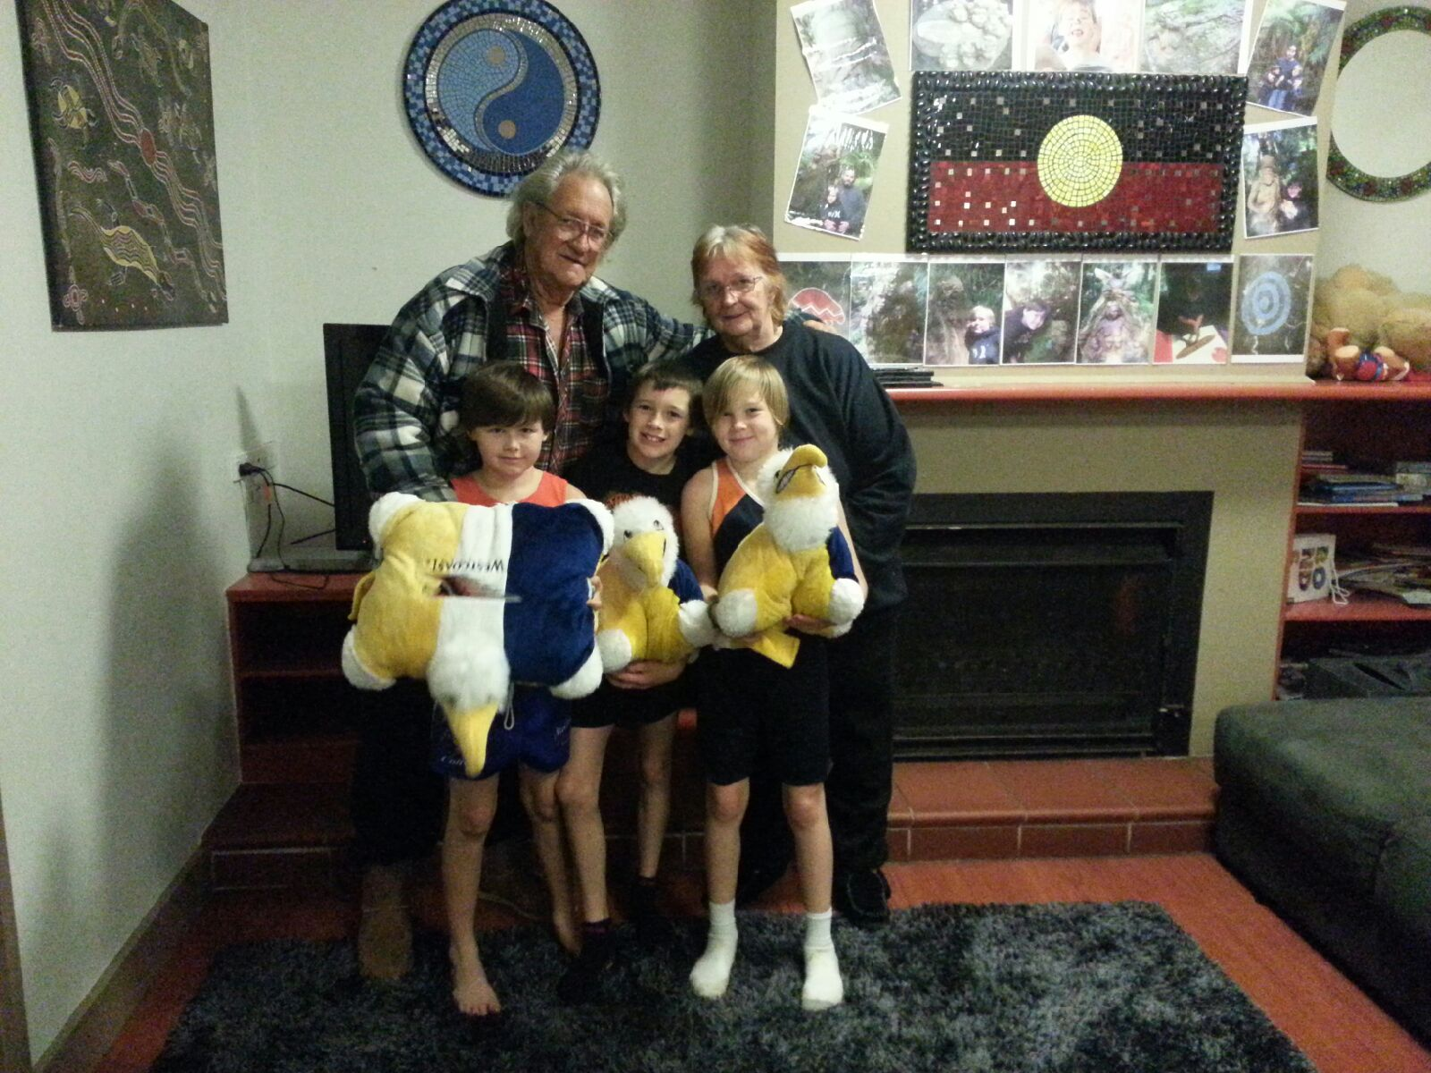
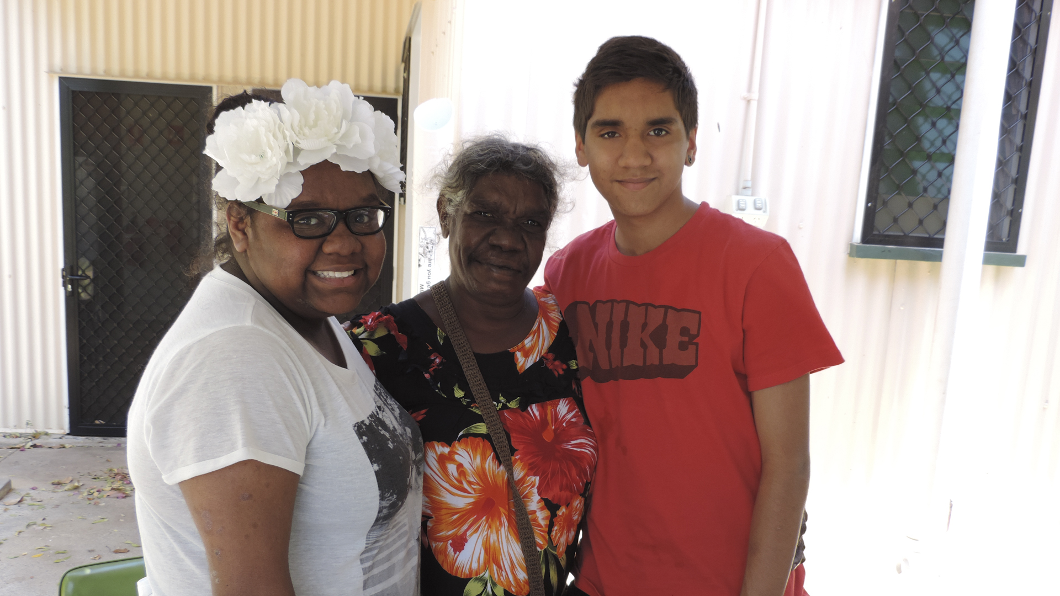
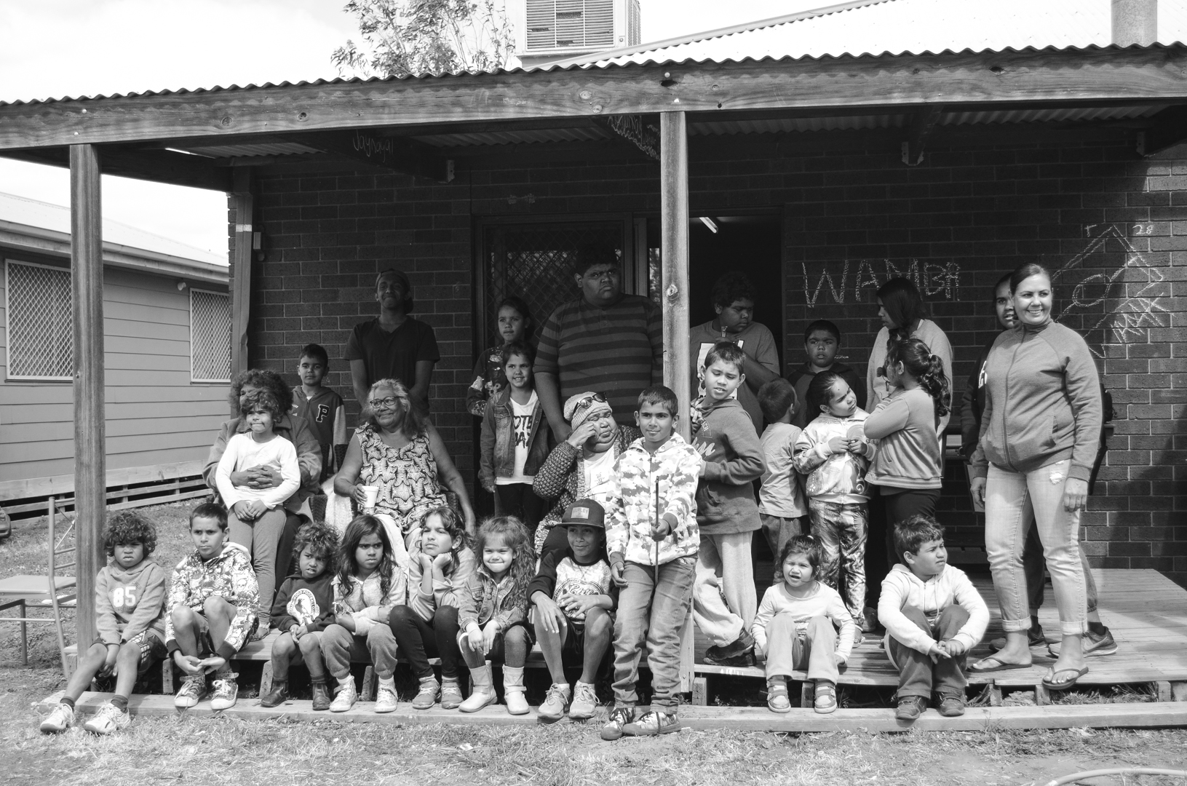
Conclusion
Notes:
These photos give just three examples of reunification and one of our objectives of our work with children. While these situations may not be perfect families we know that this is better than the isolated, disconnected and confusing lives many of our children experience while in care. 90% of children return to the families when they leave care
All the work we have been doing over the years and the new initiatives we are working towards implementing this year are designed to keep our children with their families and connected to their communities and culture to ensure they maintain their knowledge of their identity and culture.
I want to thank you all for your work so far this year. I urge you to continue to do your best for yourself and your clients.

